Slide 1


Introduction to R
Tatiana Kim

Slide 2
Learning R
A list of free R courses online: https://www.r-bloggers.com/list-of-free-online-r-tutorials/
A nice introduction for complete beginners: http://www.r-tutor.com/r-introduction
Bristol Data Scientists meetups https://www.meetup.com/Bristol-Data-Scientists/
R user groups
Google

Slide 3
About R
R is a language and programming environment for statistical computing https://cran.r-project.org/
R was created by Ross Ihaka and Robert Gentleman in New Zealand in mid 90s based on the work of John Chambers
R ranked 5th most popular programming language in the world by IEEE *
There is an open-source version of R as well as proprietary versions (e.g. MS R open R, MS R server)

Slide 4
About R
(Open source) R is a single core, multi platform, extensible environment
R is extensible via packages. Packages are fundamental units of R code: *
Package contains code, data, documentation and tests
Anyone can create an R package and distribute it via CRAN (comprehensive R archive network)
Currently there are 9875 packages available for download in CRAN

Slide 5
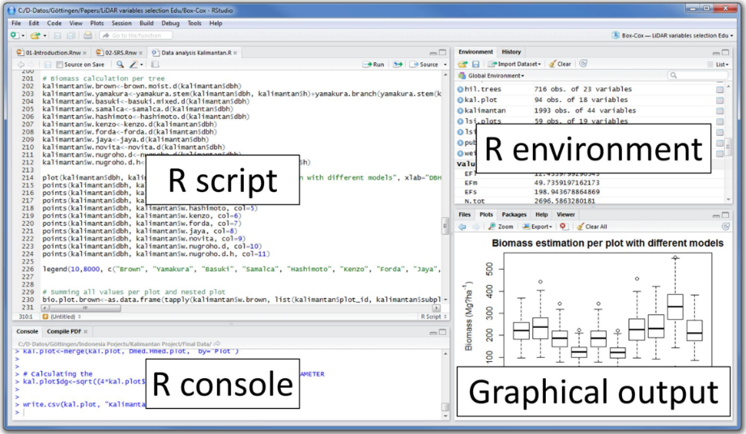
R studio Desktop
Free open-source integrated development environment for R
https://www.rstudio.com/products/rstudio/
cheat sheet
Packages / Help
Notes:
R Console: This area shows the output of code you run. Also, you can directly write codes in console. Code entered directly in R console cannot be traced later. This is where R script comes to use.
R Script: As the name suggest, here you get space to write codes. To run those codes, simply select the line(s) of code and press Ctrl + Enter. Alternatively, you can click on little ‘Run’ button location at top right corner of R Script.
R environment: This space displays the set of external elements added. This includes data set, variables, vectors, functions etc. To check if data has been loaded properly in R, always look at this area.
Graphical Output: This space display the graphs created during exploratory data analysis. Not just graphs, you could select packages, seek help with embedded R’s official documentation.

Slide 6

Data Frames in R
mydf$name
mydf[,1]
mydf =

Slide 7
Data Frames in R
mydf[1,]
mydf =

Slide 8
Outline
How to import data into R
How to manipulate data
How to visualise data

Slide 9
Data import
To import csv files use a built-in read.csv() function
Use xlsx package to import Excel 2007 files (and older versions too)
Use RSocrata package to import data from Socrata open data API
Example
Use RODBC package to connect to database management systems (need to configure ODBC API first)
Use TwitteR and RFacebook packages to import social media data
HousePriceDF = read.csv(“path-to-file/file-name.csv")
library(xlsx)
HousePriceDFxls = read.xlsx(" path-to-file/file-name.xls", sheetName = "Sheet1")
HousePriceDFxlsx = read.xlsx2(" path-to-file/file-name.xlsx", sheetName = "Sheet1")
library(RSocrata)
ParkingDF = read.socrata("https://data.bathhacked.org/resource/6e9r-8trr.json")

Slide 10
Data manipulation
dplyr – package for data manipulation written by Hadley Wickham
Select() – reduce data frame size to only desired variables
Filter() – filter by condition
Mutate() – add new variable (calculated column) to data
Summarise()
Group_by() by – group data by one or more variables
Arrange() – arrange by variables in ascending or descending order
Pipe() - %>% can be used to “chain” code together

Slide 11
Data manipulation
tidyR – package for data manipulation written by Hadley Wickham
Separate() – splits a single column into multiple columns
Unite() - combines multiple columns into a single column
Spread() – takes two columns and spreads in to multiple columns
Gather() – takes multiple columns, and gathers them into key-value pairs
**More info here

Slide 12
Data exploration
summary() is a generic function used to produce result summaries of the results of various model fitting functions
lm() is used to fit linear models, it can be used to carry out simple regression analysis
predict() is used to generate predicted values based on the linear model

Slide 13
Data visualisation
Basic plots
For a nice, concise and informative resource, see here
# Creating a Graph
attach(SpreadSalesDF)
plot(year, D)
abline(300000,0, col = "red")
abline(linear_model, col = "blue")
title("Regression of prices on detached properties on year")

Slide 14
Data visualisation
ggplot2 – package for data visualisation developed by Hadley Wickham in 2005
R graph gallery: http://www.r-graph-gallery.com/portfolio/ggplot2-package/
cheat sheet: https://www.rstudio.com/wp-content/uploads/2016/11/ggplot2-cheatsheet-2.1.pdf
qplot() – for quick plots
ggplot() – for granular, detailed, controlled plots

